Slide 1





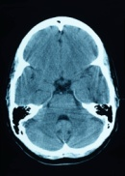

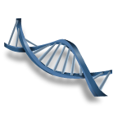


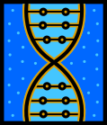


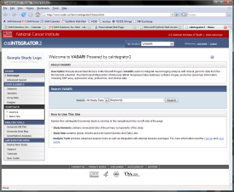
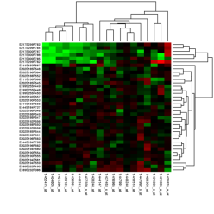


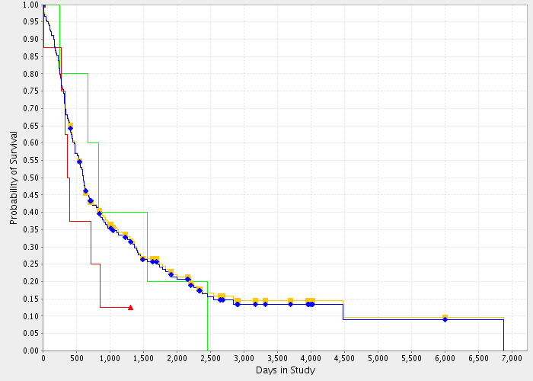
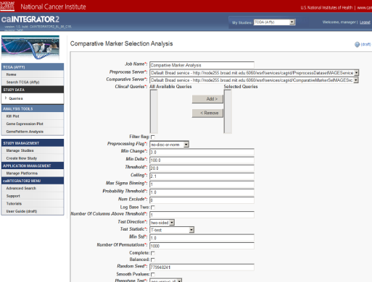

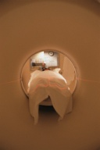
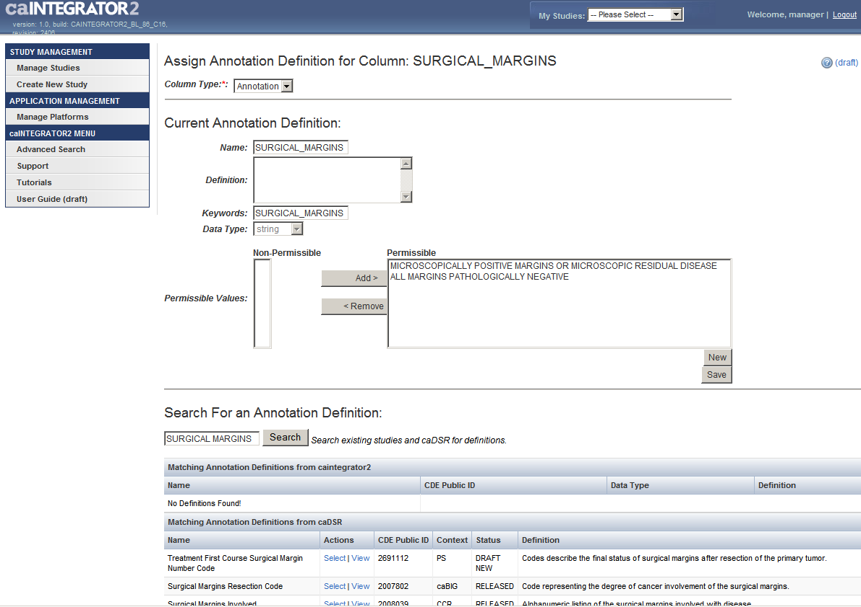
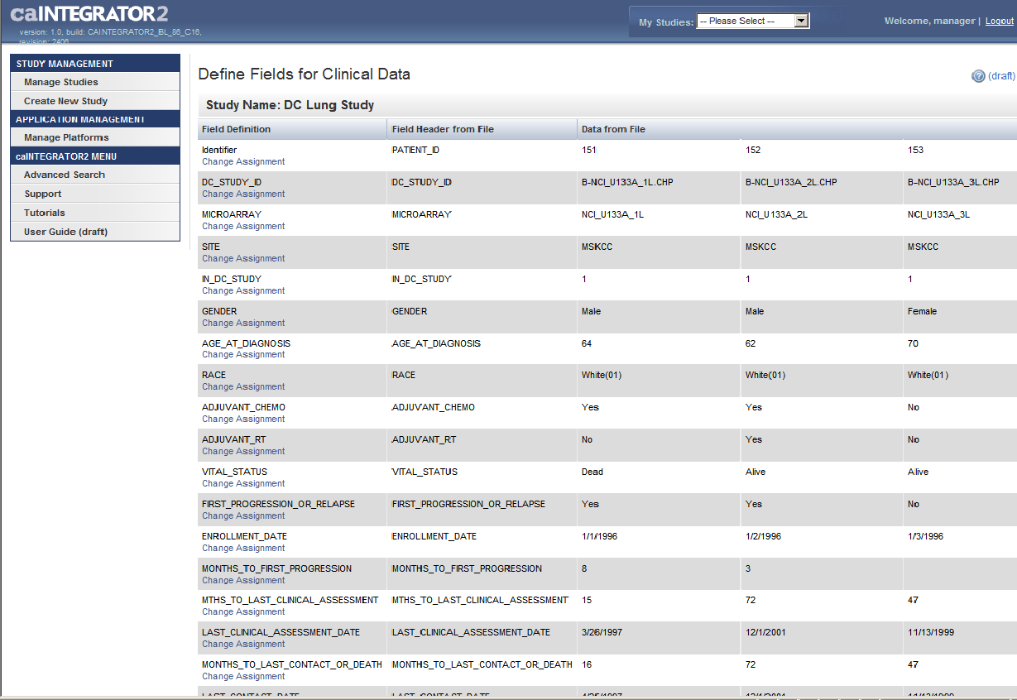
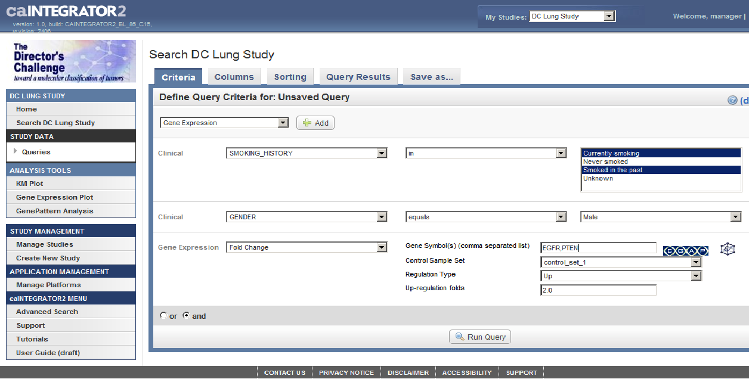
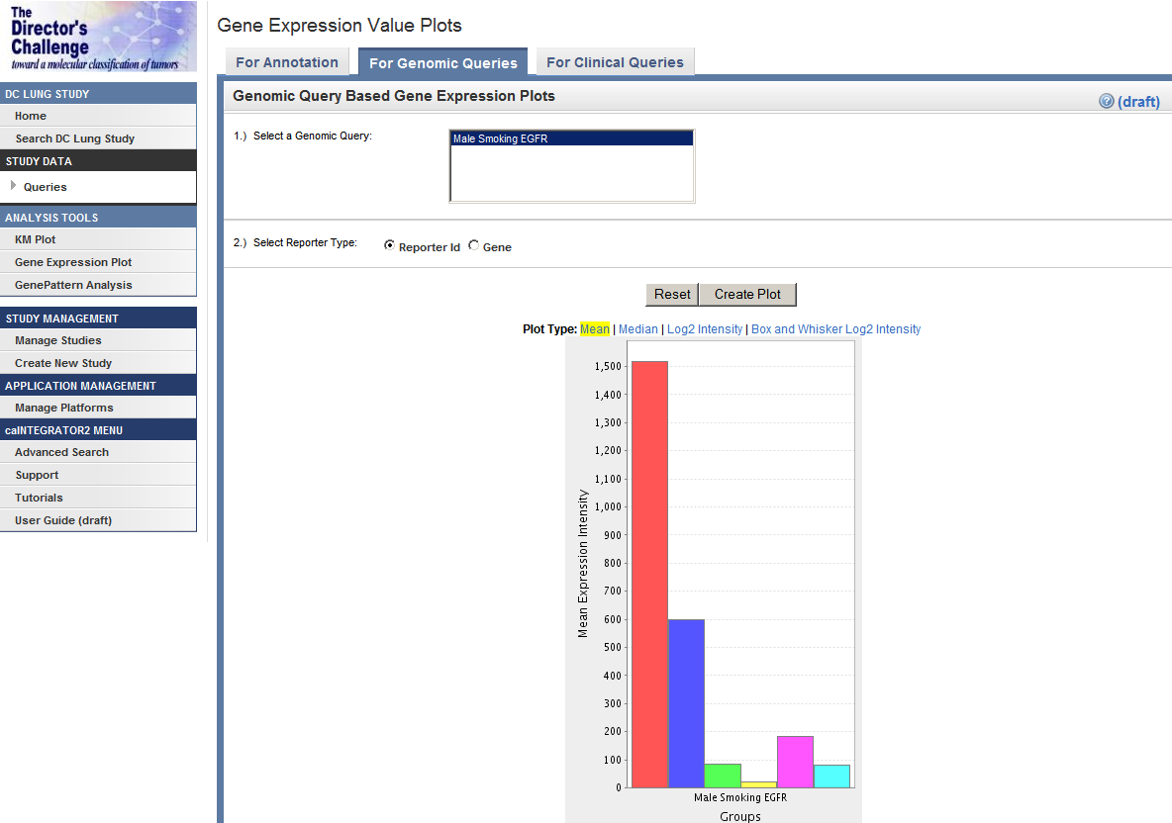
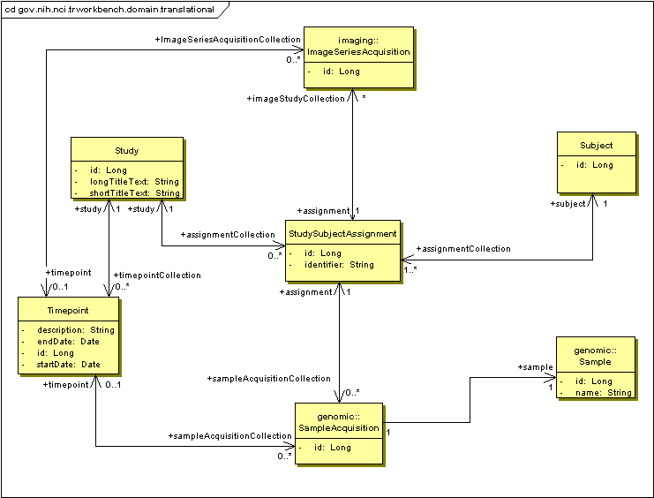
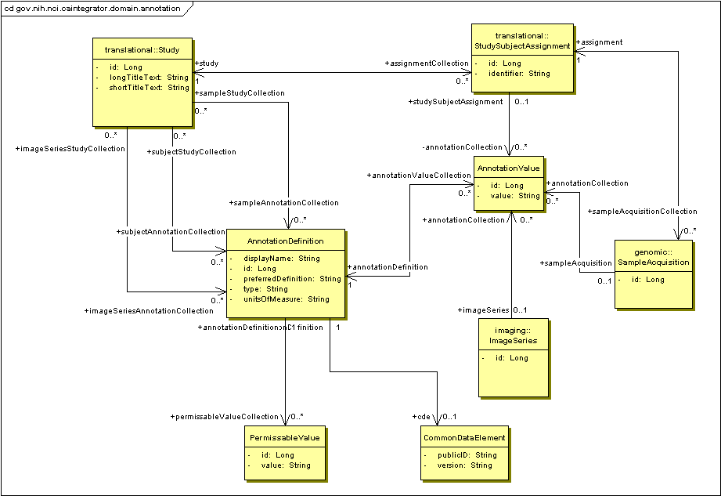

caIntegrator2: Translational Research Tool for the 21st Century
Hadfield,J.¹, Wong, C.¹, Basu, A.¹ ,Heiskanen, M.¹ ,Liu, H.², Marple, J.³, Nguyen, N.⁴,Andrews, T.⁵,Ketchum, K.⁶, Jacob, S.⁶, Phung, Q.⁶
NCI¹,SAIC²,5AM Solutions³, Claris⁴, ScenPro⁵ , ESAC⁶
Abstract
Use Cases
caIntegrator2 is a software package that allows users to set up their own custom caBIG®-compatible translational research web portals. The portals bring together heterogeneous clinical, microarray, and medical imaging data. Deploying the caIntegrator2 software does not require programming experience and is accomplished through a web interface. These custom portals allow study investigators to query, browse, analyze, and export study data. caIntegrator2 is ideally-suited for the integration of data from diverse experimental platforms and the communication of results between research teams.
C3D
(Cancer Center Clinical Database)
Patient Query Results
Gene Query Results
Query Results Saved as Spreadsheet
Clinical Data
OR
caIntegrator2
Image Query Results
Clinical Annotation Spreadsheet
Query and Browse Study Data: Research Investigators can browse and filter lists of study objects, such as patients, image series and genes. caIntegrator2 integrates with caBIO to enhance gene list selection capabilities. Research Investigators can run and create queries that produce lists of patients and their associated annotations, in a specified order. Genomic data can be queried and returned as a gene-by-patient data matrix. Query criteria can be saved and query results exported to spreadsheets.
caArray
Description
Genomic Data
(mRNA expression, array CGH)
NBIA
(National Biomedical Imaging Archive)
Image Annotation Spreadsheet
GISTIC for copy number analysis
PCA for expression data analysis
caIntegrator2 is an open-source, web-based J2EE Java application employing Spring, Struts 2 and Hibernate technologies. Data access is controlled by role-based authorization, permitting portal data to be either public or private It has built-in facilities for clinical queries, analyzing survival data (KM plots), and gene expression (plots and fold change queries). caintegrator2 uses existing analytical services available on caGrid such as GenePattern and BioConductor to perform advanced data analysis. caIntegrator2 leverages caDSR to map experimental data to well-defined datatypes and utilizes caGrid and Java client APIs to access data from caBIG® applications such as caArray, caBIO and NBIA.
Patients in Study
Imaging Data
GenePattern
Full Control Over Modules
GenePattern & Bioconductor
Select Modules Run as Grid Services
Deploy Study: The Study Manager defines the sources of data for a new study. The data is then accessed over the Grid or uploaded from files. The Study Manager defines relationships between patients, images and samples so that data can be compared reliably across the data sources. The Study Manager also defines the mapping of uploaded annotation fields to caDSR datatypes and defines survival measures.
Kaplan-Meier Plots
Perform Analysis: Data from caIntegrator2 can be sent to other software packages for more complex analysis. GenePattern provides are large collection of analysis modules, including clustering and classification analysis. Several other analysis tools are built in, including gene expression plots and Kaplan-Meier survival curves. Grid analysis services such as GISTIC and PCA are accessed from BioConductor and GenePattern.
Web Interface
Object Model
Deploy Study: These pages show how the Study Manager can search and map each uploaded clinical data field to a caDSR datatype. The detailed datatype description, field type (number, date, yes/no, etc.) and allowable values can then be read from caDSR and used to validate the data. The Study Manager will have the option to reuse the annotation on future studies.
Manage Queries: These pages allows the Study Manager to create and manage queries that can be shared with other researchers. The queries can access all fields from all data sources and complex queries can be built up from logical combinations of simpler queries. The queries can also look for correlation relationships such as genes that are up-regulated in a certain tumor type determined by imaging annotation criteria. The queries can also be used to define subsets of the data for gene expression plots and Kaplan-Meier survival analysis.
Translational Data Model: This object model shows the relationship between study subjects (patients) and the genomic and imaging data that is acquired from them. In addition, multiple timepoints can be defined for a study so that imaging and genomic data can be gathered multiple times. An example of timepoints would be ‘At Diagnosis’ and ‘After Treatment’.
Annotation Data Model: This object model shows how annotations are stored. Annotations can be associated with patients, genomic samples and image series. The Common Data Element object defines a relationship with a caDSR datatype if an appropriate one can be found.
Future Directions
Integration with visualization tools like PCA viewers, heat maps, and genome browsers.
Support new data types including DNA- methylation, microRNAs and next-gen sequencing.
Coordinate with NBIA to import AIMS image annotations directly using caGrid APIs
Survey cancer research communities to identify and incorporate new features.
2010 NCI-NCRI Informatics Initiative Joint Conference- Bethesda, MD June 21-22

